Slide 1
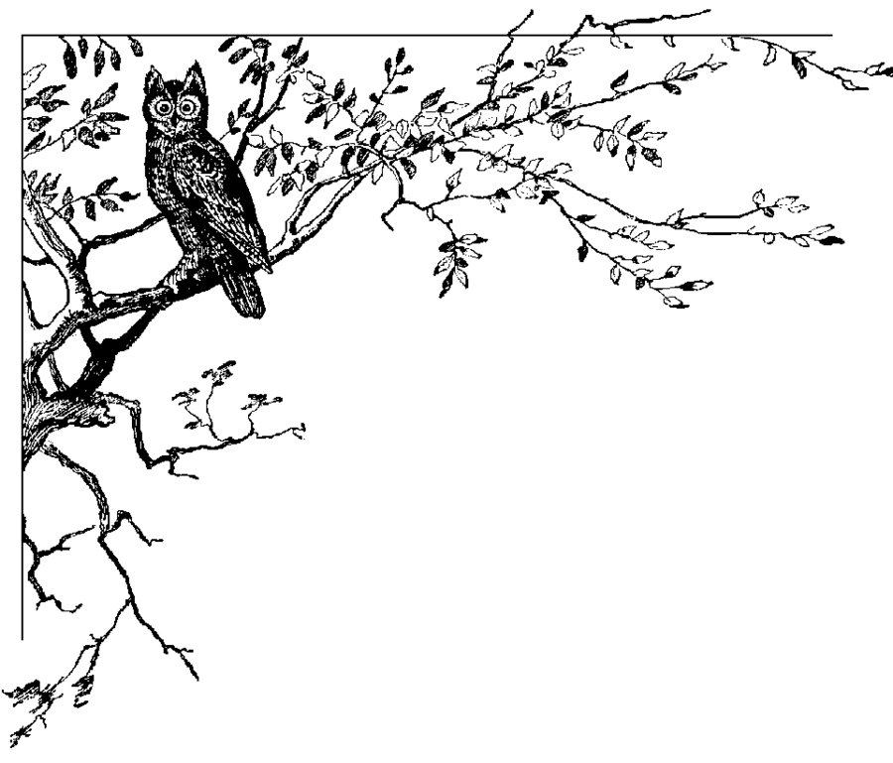
Twitter Bot
Rachael, Nicole, Dionysis, Stuart, Rory

Slide 4
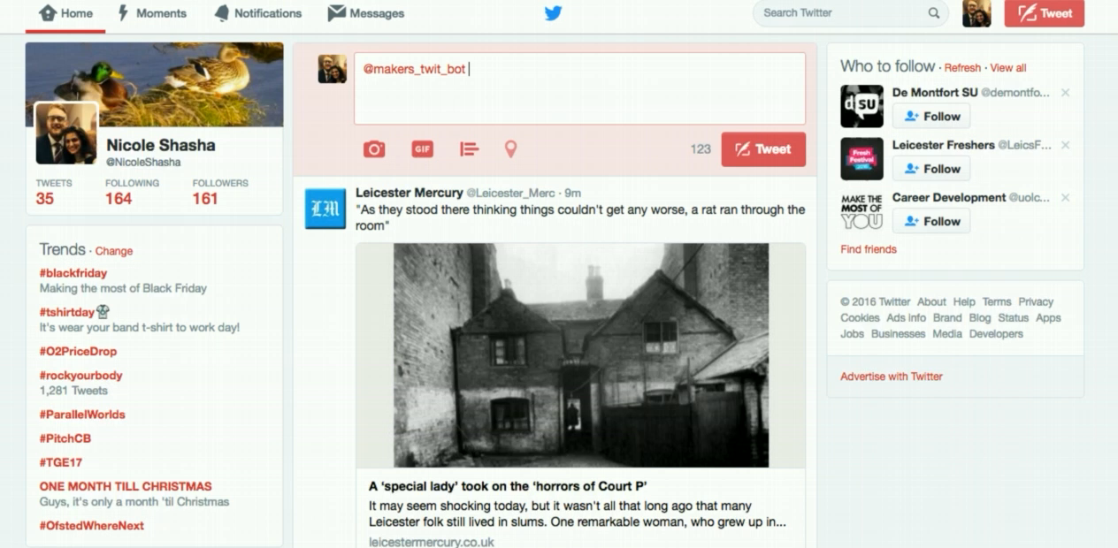
In action

